Slide 1
Action for Carers
2021

Slide 2
“To enable carers of all ages to have a voice, and access support to improve their quality of life and wellbeing.”
Notes:
This is ACS’s vision:
Our vision is to enable all of Surrey’s (unpaid) carers to have a voice, and access support to improve their quality of life and wellbeing.

Slide 3
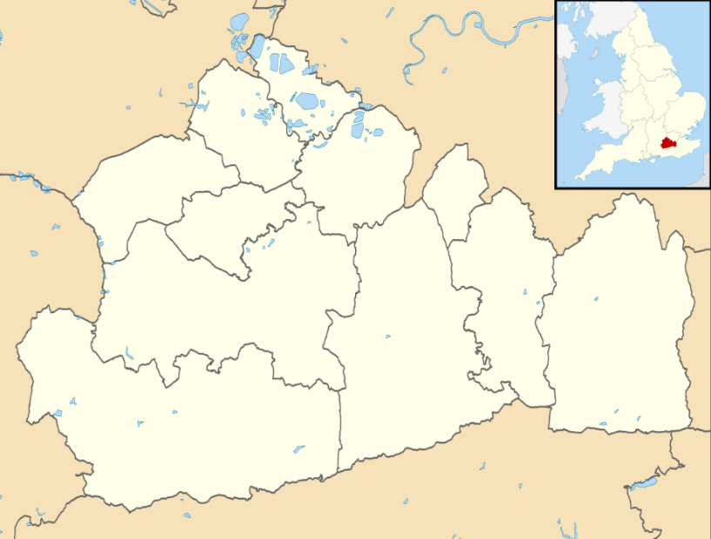
Who are carers?
A carer is anyone who cares, unpaid, for a friend or family member who, due to illness, disability, a mental health problem or an addiction, cannot cope without their support.
They should not be confused with paid care workers.
There are many carers in Surrey.
115,000 Adult Carers
14,000 Young Carers

Slide 4
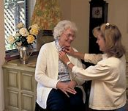
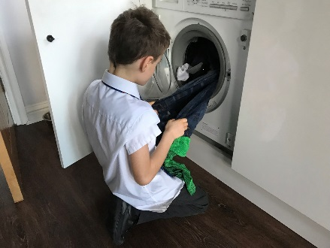
Why are carers important?
Reduce admissions to hospitals
Provide personal support
Provide practical support
Enable people to remain in their own homes
Reduce admissions to residential care
Provide emotional support

Slide 5
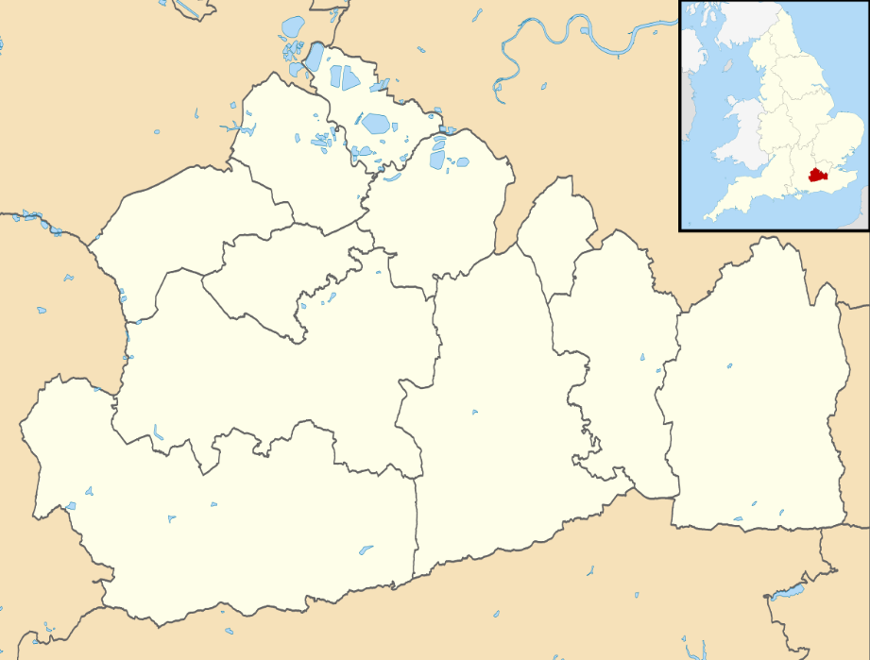
Why are carers important?
Nationally they save us £132 billion per annum
= + £10 billion
In Surrey: £2 billion

Slide 6
How does Action for Carers Surrey help?
Action for Carers is a carer-led charity supporting carers aged 5-95, right across Surrey.
As well as our general offer, we have specialist support:
for under 18s,
for young adults (18-24),
for people who need help with moving and handling the person they care for, and
for carers in or connected to the Armed Forces.
We’ve been helping carers since 1992.
Notes:
We support carers of all ages, from Hersham to Haslemere, Frimley to Fairleigh. We support all carers but know that early intervention to support carers is key – the sooner people identify as a carer, and come for us to support and information, the better their life is likely to be.
We’ve been supporting Surrey’s carers for over 25 years.

Slide 7
Where does Action for Carers operate?
North West Surrey
Mid Surrey
Farnham
East Surrey
South West Surrey

Slide 8
What support do we offer?
A one stop shop for all carer services

Slide 9
What support does Action for Carers offer?
(
T
R
I
A
G
E
All referrals into a single point (including Carers Prescriptions) 0303 040 1234
What support do we offer?
A one stop shop for all carer services
Increased presence in the county’s hospitals
Emotional
Support
1:2:1s
Training & events Carers Groups
Digital Offer
Countywide Leads
Notes:
REPEATED SLIDE – RB TO AMEND UPDATE BUT VERSION THAT I CAN EDIT PLEASE

Slide 10
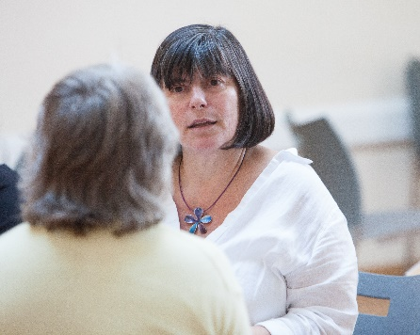
Adult Carer Support
We have a broad offer for adult carers, including:
Face-to-face and telephone support, for information, advice and signposting
A wide range of events (on Zoom and locally): from learning, training and information, to wellbeing and relaxation sessions, giving carers time out from their caring role – over 40 take place each month
Support groups and workshops
Benefits advice, including guidance on what you’re entitled to, and help with completing forms
Advocacy, and information on your rights as a carer
Carer Advisors in Surrey’s five main hospitals – giving advice, information and emotional support and aiding communications between the carer and staff
A wealth of free resources, including regular newsletters, email updates and www.actionforcarers.org.uk
Specialist support, for example for parent carers, on dementia, or mental health.

Slide 11
Carer Information Centre
Our Carers Information Centre provides carers, their wider family and friends with advice, information and support by phone, text and email.
Our friendly advisors will talk through any caring issues, practical, emotional, financial or legal.
Just give them a call on 0303 040 1234, text 07714 075993, or email CarerSupport@actionforcarers.org.uk It’s open Monday, Thursday, Friday 9am-5pm; and 9am-6pm on Tuesdays and Wednesdays.

Slide 12
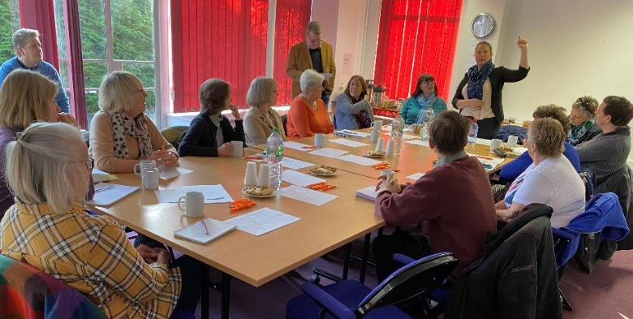
Giving Carers a Voice
Our Giving Carers a Voice programme encourages carers to use their experiences to influence change for other carers, both locally, and nationally
We run our own consultations with carers, and offer others in partnership, on a variety of issues of concern to carers, and alert our carers to relevant external consultation opportunities.
We also run a ‘Carers Parliament’ a group to advise and direct on key matters. And we also have Forums for young carers and young adult carers to share their views and experiences.

Slide 13
Support for young carers, 5-18
Surrey Young Carers is our service for carers aged under 18. It offers:
Free, impartial information and support to young carers and their families on minimising the impact of their caring role.
Workshops, forums, activities and groups.
Support in schools, to teachers and pupils, from our Education Advisors.
Time out from their caring role, a chance to meet others in similar situations, and help to reach their full potential.
A young carer is someone under the age of 18 who provides ongoing, unpaid care for a sibling, parent, or other family member.

Slide 14
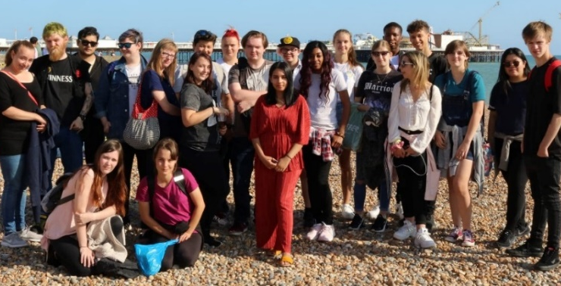
Support for young adult carers
Our Young Adult Carers service supports 18-24 year olds, helping them to achieve a healthy balance between their caring role and developing independence. Support includes social activities, information events and help with education, employment, money management and more.
Additionally we enable young adult carers to have a say, by taking part in our Forum to advise and campaign on caring issues.
“Now I’m at uni, I’m heading into my third year studying costume design and making! If it wasn’t for Action for Carers, no way would I be at university now. More than likely I would be homeless or would have been homeless 100% at one point. And I would definitely be struggling a lot more with mental health and wellbeing issues.”

Slide 15
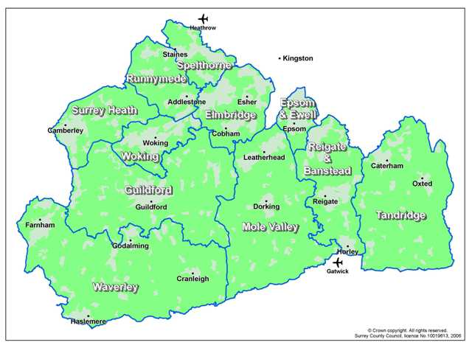
Support in moving and handling
Our Moving and Handling service provides safe solutions for carers who carry out moving and handling as part of their role.
We offer information, advice, training and support to help carers prevent potential injury to themselves or the person they care for.
WL
WL
WL
WL
WL
ACS
ACS
ACS
ACS
ACS
This service is delivered in partnership with White Lodge. They cover the north of Surrey, Action for Carers covers the south.

Slide 16
Support for Armed Forces carers
Action for Carers Surrey’s Armed Forces service offers tailored advice and support to anyone caring for someone who’s either in, or part of the family of, serving Armed Forces personnel, veterans and reservists.
Our Co-Ordinator’s specialist knowledge of the challenges of Armed Forces family carers allows us to provide tailored support and information, to this important Surrey community.

Slide 17
How you can get involved
There are many ways to get involved with Action for Carers Surrey, from using your experience to improve other carers’ lives, to volunteering and fundraising.
Fundraise – join our fundraising events, fundraise as an individual, or support us as a community group or company, or make a donation
Volunteer – we have a range of opportunities
Use your voice – take part in consultations and campaigns
Share you story – let people know about your experience
Please get in touch to find out more!
Notes:
More on all these opportunities on our website: https://www.actionforcarers.org.uk/get-involved/
For fundraising email fundraising@actionforcarers.org.uk
For using your voice or sharing your story email digital@actionforcarers.org.uk

Slide 18
Thank you
Please do get in touch with us to find out more.

